Slide 1
Lawrence Livermore National Laboratory
Laboratory Overview
xxxxx
xxxxxx
Computing Resume Workshop
July X, 2024
Notes:
DC Review Information
Guides: CG-CB-2 DOE OC Chg 1 7/02; CG-DAR-2 DOE OC 8/98; CG-ICF-6 DOE OC Chg 1 7/12; CG-IN-2 DOE OC 3/22/19; CG-NEM-1 DOE OC Chg 1 8/09/01; TCG-NNT-3 DOE OC Chg 1 2/03/17; CG-NP-4 DOE OC 11/13/19; CG-RER-1 DOE OC Chg 4 7/08/02; CG-TNF-1 DOE OC 7/05/13; CG-W-5 DOE OC Chg 15 10/16/95; TCG-WM-2 DOE OC Chg 1 10/15/10; CG-WPMU-3 DOE OC Chg 3 12/13/13; TCG-WS-1 DOE OC Chg 9 10/09/84; WNP-162 DOE OC 10/25/16; BLU-129/B SCG Chg 1 9/24/10; DOE/NV—209-REV 16 9/15
Topics: CB 1110, 3100, 3310, 5110, 5120, 5140, 8120, 8130; DAR: 400 series; ICF: 101.1, 101.2, 101.4, 102.1, 102.2, 102.6, 103.1, 103.2, 103.3.14, 105.1, 105.3(U), 106.2(U); IN: 108.3.1, 108.3.2, 109.1; NEM: 104.1; NNT: 101.6.4, 104.1.1, 201.1.4.2; NP: 601.1, 601.3, 603.3, 701.3; RER: 1101.1, 5103; TNF: 101.4, 102.5.3, 102.5.4; W: 841.1, 841.3, 892; WM: 211.1, 805.1.2, 918.1.3; WPMU: 101.1, 101.3, 102.1.3, 102.1.4.2, 102.3.1, 103.2.4, 204.1.4.1, 206.5.3; WS: 101.2, 105.6; WNP-162: 2, 4, 7.2; BLU: IV.1,2,3
IPAC/OCEC Questions No In my opinion, the document describes a new apparatus, new structure, combination of structures, ... No I consider information in this document to be ... published and shared broadly within the scientific community...
IM #1046536
LLNL-PRES-830343
12_21_21

Slide 2
Agenda
Introductions
Lab Overview
Crafting your resume
Resume feedback
Questions
LLNL-PRES-839142

Slide 3
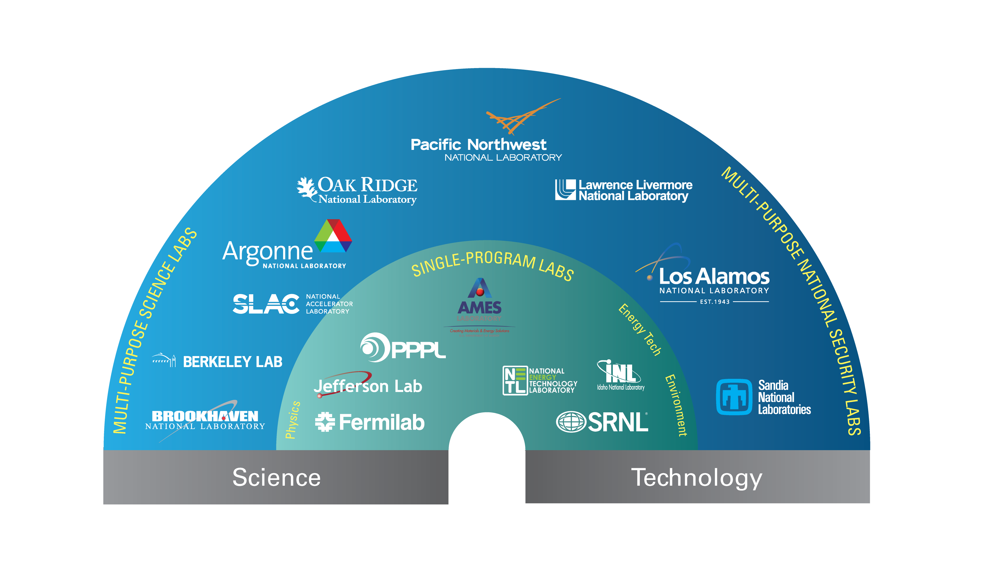

LLNL is one of 17 DOE national laboratories
LLNL-PRES-839142
Notes:
ALTERNATE SLIDE
We are one of 17 DOE national laboratories in the nation, and one of 3 National Nuclear Security Administration national labs. We are a multi-purpose, multi-program national security lab and have the third largest budget, just behind LANL, in the DOE system.

Slide 4
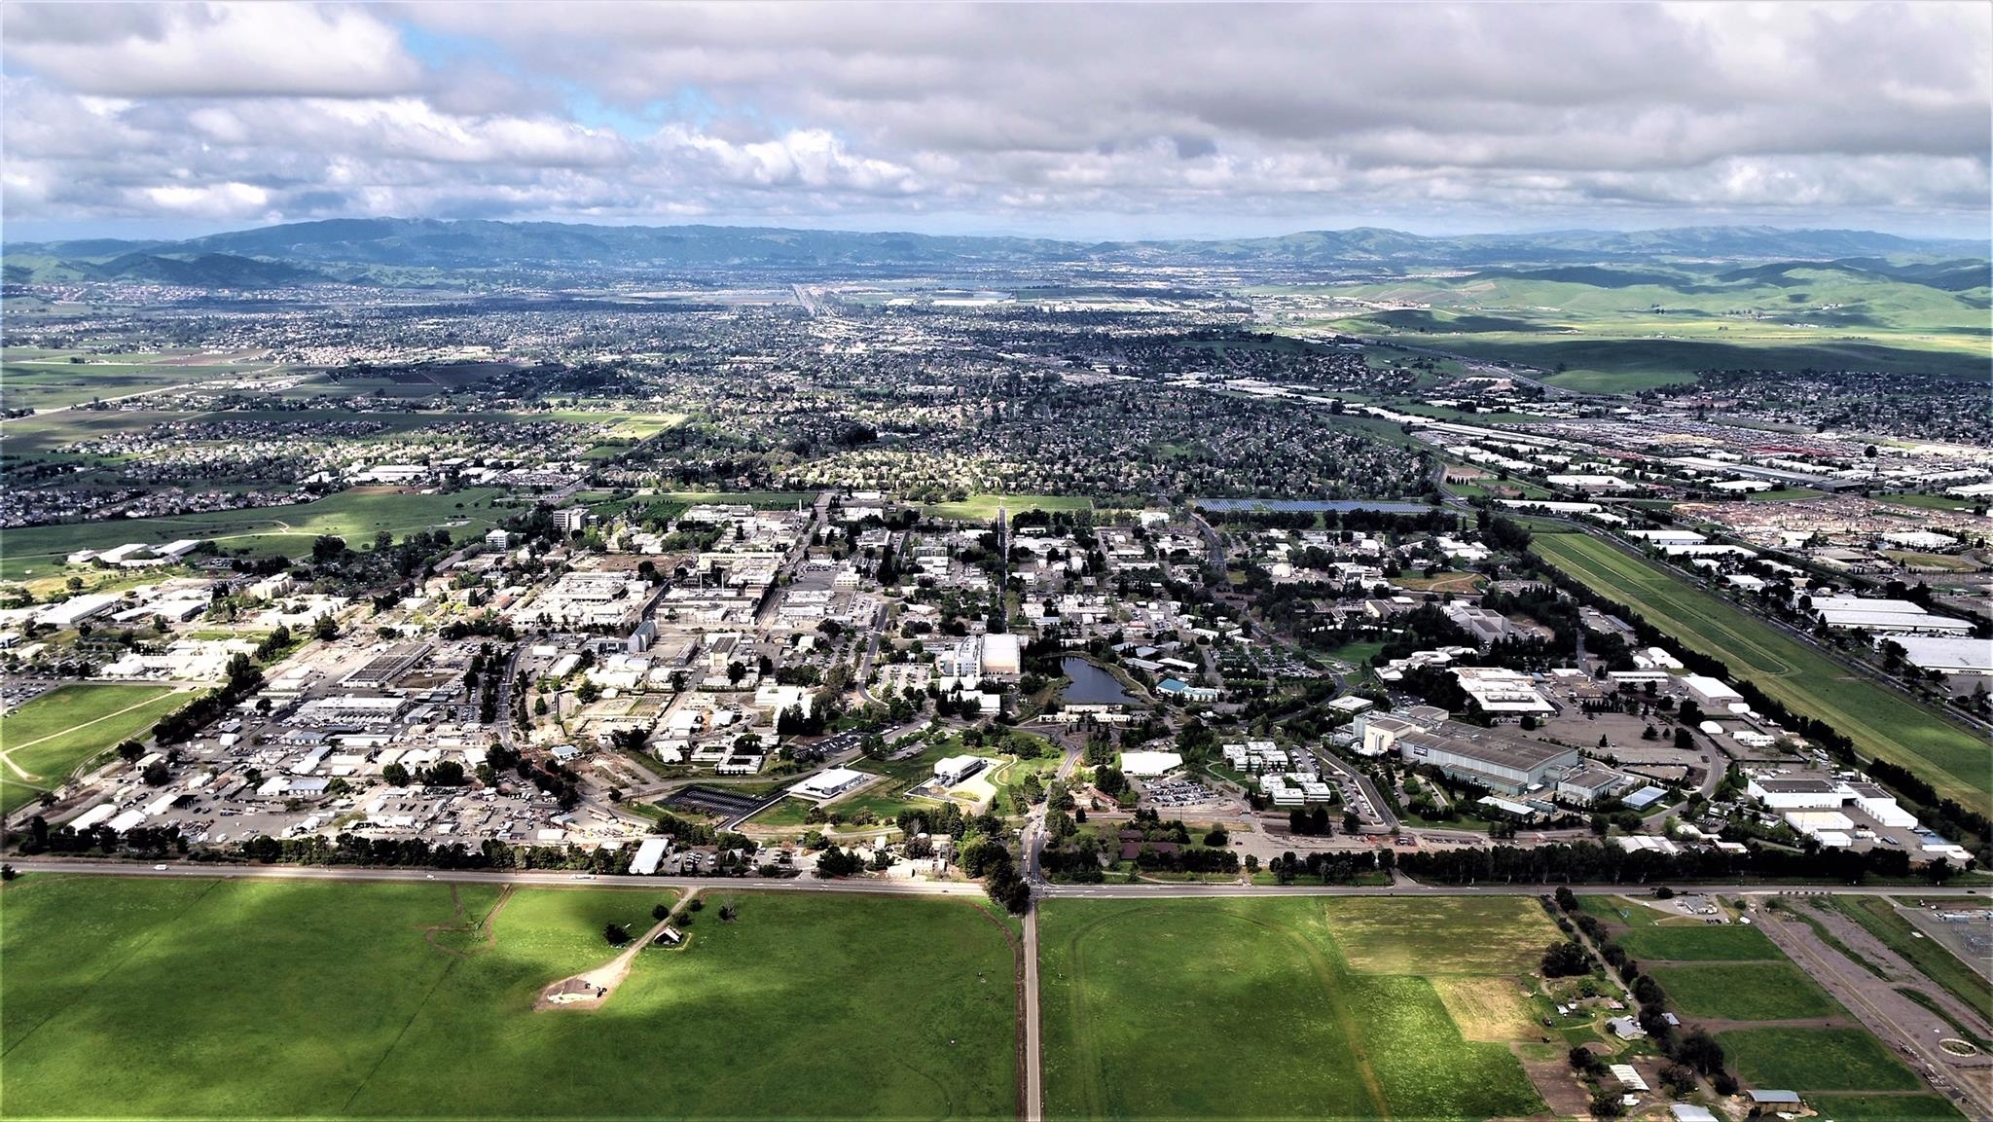
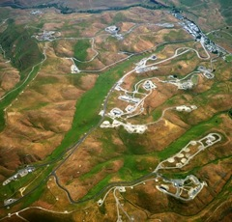
Lawrence Livermore National Laboratory Where new ideas are built on exceptional science and technology
Established in 1952
Approximately 8,200 employees
1 square mile, >500 facilities
Annual federal budget: $2.8B
>150 R&D100 Awards
Experimental Test Site (11 sq. mile site near Tracy, CA)
LLNL-PRES-787360
Notes:
Owned by the Federal government, operated by LLNS, LLC
FY21 fact sheet: https://www.llnl.gov/sites/www/files/2022-05/LAB_AT_A_GLANCE_FY21.pdf
R&D 100s: https://ipo.llnl.gov/index.php/
$2.8B figure was confirmed in O&B All Hands meeting on 6/8/22

Slide 5
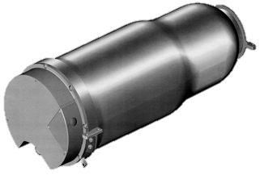
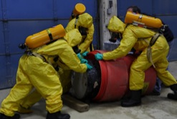


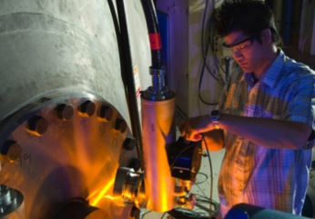
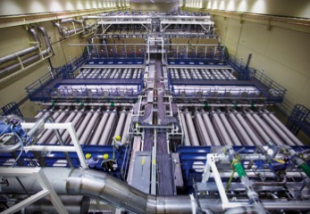
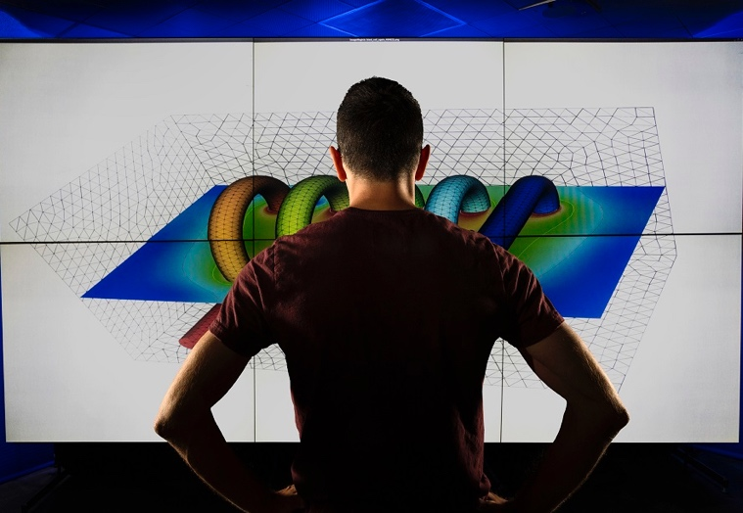
Our mission is to strengthen the nation’s security through world-class science, technology, and engineering
Stockpile Stewardship
Global Threat Reduction
Multi-Domain Deterrence
Climate and Energy Security
Science
Engineering
Computing
Anticipate • Innovate • Deliver
LLNL-PRES-787360
Notes:
At LLNL, our mission, simply put, is to apply frontier science and technology to enhance national security.
A national security lab:
In addition to our primary responsibility to support strategic deterrence by ensuring the safety, security, and effectiveness of the U.S. nuclear stockpile; we work to counter the spread and potential use of nuclear, radiological, chemical, or biological weapons of mass destruction, including engaging in cooperative threat reduction activities around the world.
As part of our broader national security mission, and in support of DOE's missions, we do R&D in energy technologies and systems, expand the frontiers of fundamental science, and provide solutions to the nation’s warfighters.
The Laboratory (1) works closely with academic institutions to advance fundamental research relevant to our missions and (2) supports STEM education to help train the technical workforce needed to meet future national security challenges.
Partnering with industry through technology transfer and commercialization are critical elements in translating the Lab’s solutions to end-users, and to contributing to national security through enhancing economic competitiveness. By the nature of the Lab’s historic mission to deliver systems to the field, working closely with industry is part and parcel of our practice.
There is an interconnectedness – a fabric – that runs through our programs. Our principal mission supporting the nuclear deterrent requires a set of capabilities – facilities and workforce, an approach to problem-solving, and a mission-first culture, that we’re able to apply to broader national security areas, as well as the broader set of DOE missions. In turn, the capabilities needed for our deterrence mission are strengthened and kept vigorous through the breadth of work we do.
Now, this connection is self-evident for our work in nuclear nonproliferation and counter-proliferation, and our program applying all-source intelligence to foreign nuclear weapon assessments. But our combination of mission focus, pushing S&T boundaries, and the need to anticipate disruptive developments, has led to our being looked to for all-WMD intelligence support, counterterrorism, forensics, and advances in aspects of cross-domain deterrence – such as cyber security, space situational awareness, and ISR (intelligence, surveillance, and reconnaissance).
The connection is perhaps a bit less obvious in an area such as climate change, but testing the frontiers based on our mission and capability led Livermore to pioneer the first global circulation models – to understand fallout and the question of “nuclear winter.” These GCMs were the forerunners of modern climate prediction codes, and we have maintained a unique role for DOE – and the IPCC – in evaluating and diagnosing climate models. In fact, it was a Livermore scientist who authored the chapter of the 1995 IPCC report that first identified a “discernible human impact on climate,” a particularly consequential example of changing the game. This work contributed to the 2007 Nobel Peace Prize, awarded to the IPCC and former VP Al Gore.
Other examples:
Right now, our priority is to deliver the stockpile modernization plan of record, including the W80-4 LEP for the LRSO cruise missile, and technology development for IW-1, the W78/88-1 LEP, which is scheduled to begin in FY20. Our goal is to provide a set of cost-aware options for life-extending and improving safety and surety of these systems. To do this, as well as to perform ongoing annual stockpile assessments, we rely on a suite of science tools, research efforts, and advanced development that define the science and technology base of the Laboratory.
We are also in the process of improving our tools, such as through recently fielding the 125-pf Sierra system in 2018. Our HPC and simulation capabilities represent the integrating machinery for testing warheads, as underground tests were in a previous era.
The National Ignition Facility (NIF) is a stockpile stewardship workhorse, regularly performing more than 400 shots each year for NNSA, other national security sponsors, and academic users. Plutonium experiments on NIF collect unique data under primary operating conditions that will directly impact our simulation codes. As the only facility in the world capable of achieving temperatures and pressures characteristic of thermonuclear systems, NIF delivers unique, crucial data on material properties, nuclear physics, radiation transport, and hydrodynamics. Its value to stockpile stewardship was demonstrated in the role it played in resolving a decades-old quandary in the nuclear test database concerning energy balance. It has been featured on the cover of Science magazine for recreating conditions at the center of Jupiter.

Slide 6

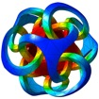

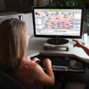

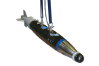

LLNL’s core mission enables and benefits from our broader portfolio of work
Global Climate – UQ (Uncertainty Quantification)
Stockpile Stewardship
Basic science
Industry
partnerships
Material Properties
All-WMD Threat Reduction
Biosecurity/ biotech
Sensors
NNSA
Missions
Multi-Domain Deterrence
Warfighter
support
Intelligence Analysis
Resource
security
Conventional Munitions
Energy Security and Climate Resilience
Homeland
security
Cyber Security
LLNL-PRES-830343
Notes:
Large funding in Nuclear Weapons Program has led to scientific discoveries apply in other disciplines.

Slide 7
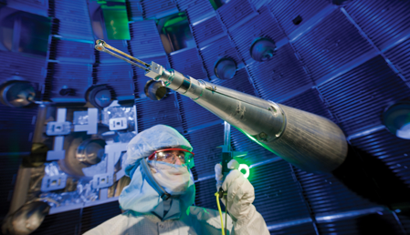
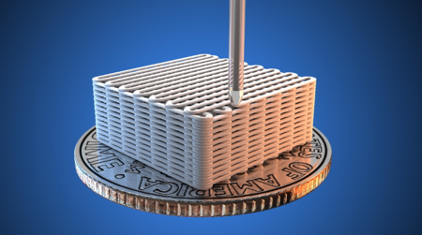
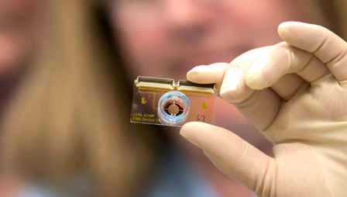
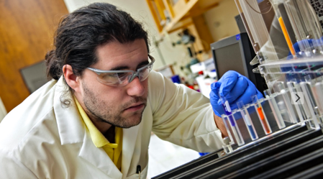
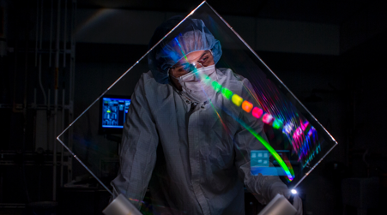
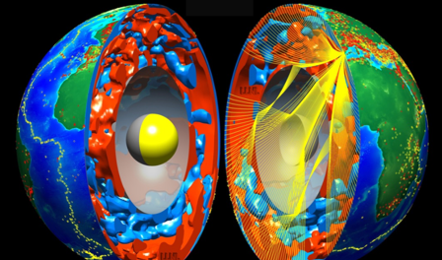

High-Energy-Density Science
Advanced Materials and Manufacturing
Bioscience and Bioengineering
Nuclear, Chemical, and Isotopic S&T
Laser and Optical S&T
Earth and Atmospheric Science
Core Competencies
High-Performance Computing, Simulation, and Data Science
LLNL-PRES-830343

Slide 8
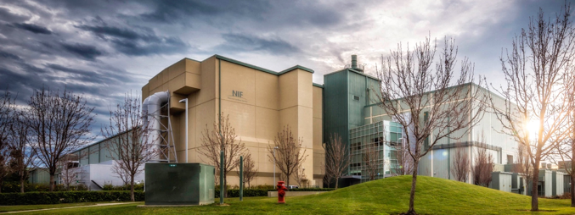
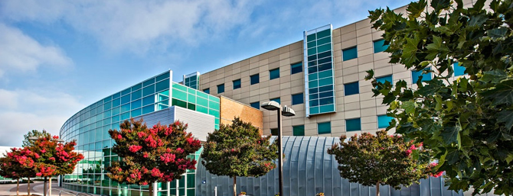
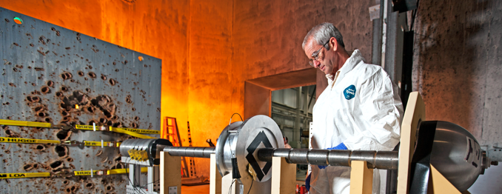
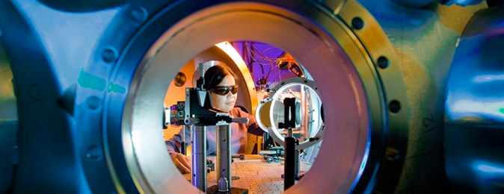
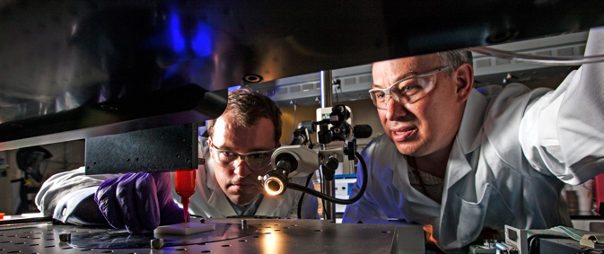
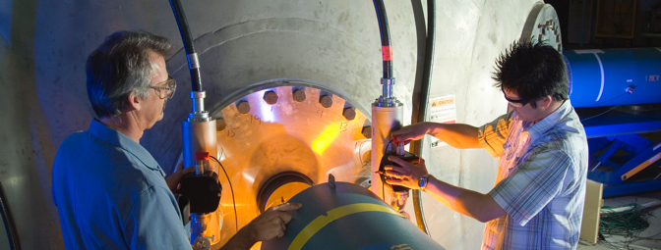
National Ignition Facility
Livermore Computing Complex B453
Site 300
Jupiter Laser Facility
Unique R&D Facilities
Advanced Manufacturing Laboratory
High Explosives Applications Facility
LLNL-PRES-830343

Slide 9

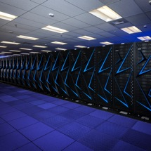
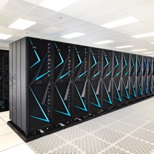
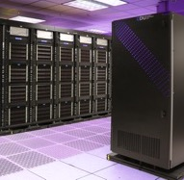

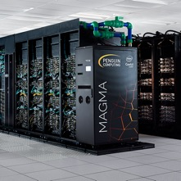
LLNL is home to four of the world’s most powerful supercomputers
A total of
at Livermore Computing
Sierra 94.6 petaFLOPs
#3
187
petaFLOPS
Lassen 18.2 petaFLOPs
#26
Ruby 3.7 petaFLOPs
#123
Magma 3.24 petaFLOPs
#143
FLOP = floating operations per second
LLNL-PRES-830343
Notes:
R_{peak} values are calculated using the advertised clock rate of the CPU. For the efficiency of the systems you should take into account the Turbo CPU clock rate where it applies.
LLNL has a total of six machines on the TOP500 List, also tops among supercomputing centers. The other systems making the list were the Penguin/Intel CTS-1 commodity clusters Jade and Quartz, at 211 and 212 respectively.
El Capitan is currently being build and will be fully deployed in 20S3 2.0 exaFLOPs
Will be the worlds most powerful supercomputer

Slide 10

Ideas
Our VALUES are the concepts that embody what we’re all about. They are the things we value in and of themselves. Each of us should bring our unique experiences, aspirations, and roles within the Lab to their interpretation and application.
Impact
Integrity
Inclusiveness
Zeal
LLNL-PRES-830343

Slide 11
Review of resume writing tips
Prior experience
Articulate your skills
Project, posters and presentations
Review job posting
Resume Example
Breakout Session (30-45 minutes)
Q&A
Resume Order
Contact Information
Name, email, and phone number
Education
Relevant Course Work
Technical Skills
Programming languages from strongest to weakest
Include knowledge of software tools
Special skills
Experience
Projects
Posters &/or Presentations
Community & Leadership
Technical managers start with a quickly scan a resume for key technologies and skills
Notes:
Agenda on the left
What is the purpose of a resume?
Resume is a concise picture of your skills and qualifications for a specific position, so length tends to be shorter and dictated by years of experience (generally 1-2 pages).
Recommended resume order on the right
This order allows hiring mangers to quickly scan you resume for key skills to fill their project needs.

Slide 12
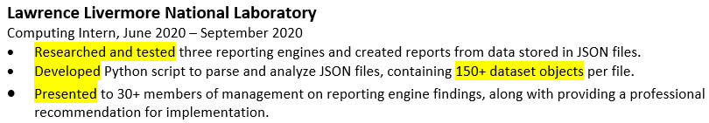
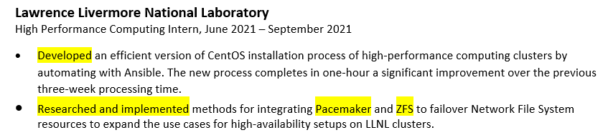
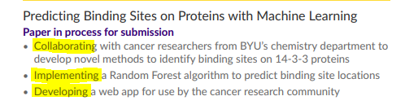
Prior Experience – Jobs and Projects
What did you do?
How did you do it?
Why did you do it?
What technologies did you use?
Quantify, provide stats or metrics when possible
Size of the dataset
Scaling code X times faster
Document languages and technologies for each job and project description
Notes:
First example technologies? Matlab, R or Python or something else?
Second good example of technologies and why missing? Maybe class assignment
PDE – Partial Differential Equations
Future – some Software Developer resume examples

Slide 13
Articulate your skills
Strong Action Words
Designed
Developed (Developed an algorithm for….)
Implemented
Researched (Researched methods for machine learning….)
Evaluated
Analyzed
Authored/Co-Authored
Presented
Collaborated (Collaborated with five scientists at LLNL from unique domains…..)
Correlated
Skills
If 80% of the population can perform the skill, do not add it (example: word, excel)
Programming languages – list from strongest to weakest
Each job or project description should start with strong action words

Slide 14
Projects, posters, and presentations
Include personal and school projects, posters, and presentations
Examples of important facts to note
If you won an award at a conference
If you presented your work at a conference, internship, or to school colleagues
If you participated in an event as a leader or subject matter expert
List most relevant to least relevant
Note posters or presentations separately
When not associated with work cited on the resume
Projects, posters, and presentations provide support for your skills and qualifications
Notes:
Interviewers may look up poster or presentation citations to learn more about your research, how you presented it and your role in the presentations.
Posters or presentations: For example, if a previous employer gave you a project as part of your work duties, highlighting it under the work section rather than listing it in the presentation section.

Slide 15
Review job posting
Computing Careers
https://computing.llnl.gov/careers/interns
Review the qualifications of an exiting job postings

Slide 16
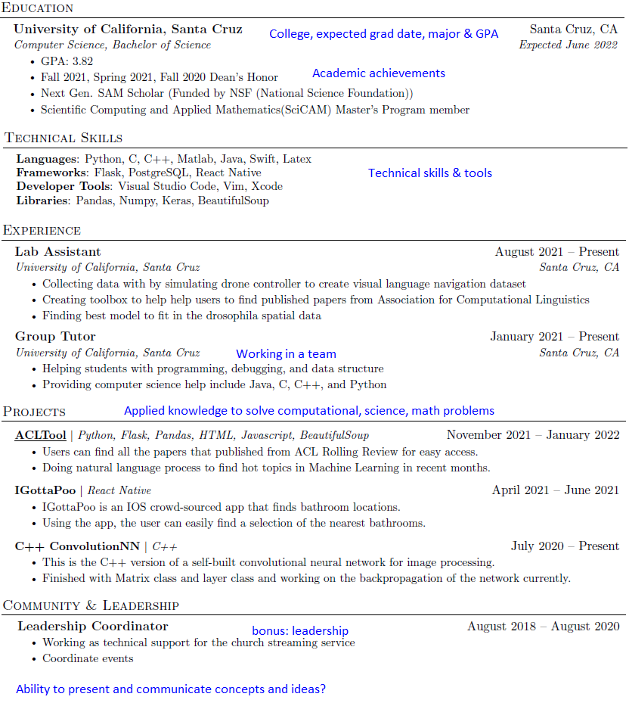
Resume Example
Contact Information
Education
Technical Skills
Experience
Projects
Posters &/or Presentations
Community & Leadership
Consider Projects section before Experience, if projects demonstrate technical skills
Notes:
Software Developer/ Computer Science Example resume
Don’t forget your contact information, email and phone number
No pictures, fancy fonts or colors don’t scan or OCR well
We recommend you keep resumes to no longer than 2 pages with key skills noted on first page.

Slide 17
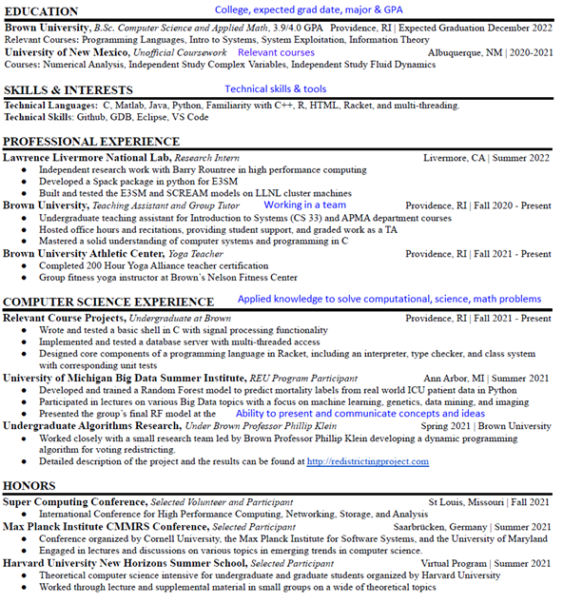
Resume Example
Contact Information
Education
Technical Skills
Experience
Projects
Posters &/or Presentations
Community & Leadership
Notes:
Data Science Example resume
Don’t forget your contact information, email and phone number
No pictures, fancy fonts or colors don’t scan or OCR well
We recommend you keep resumes to no longer than 2 pages with key skills noted on first page.

Slide 18

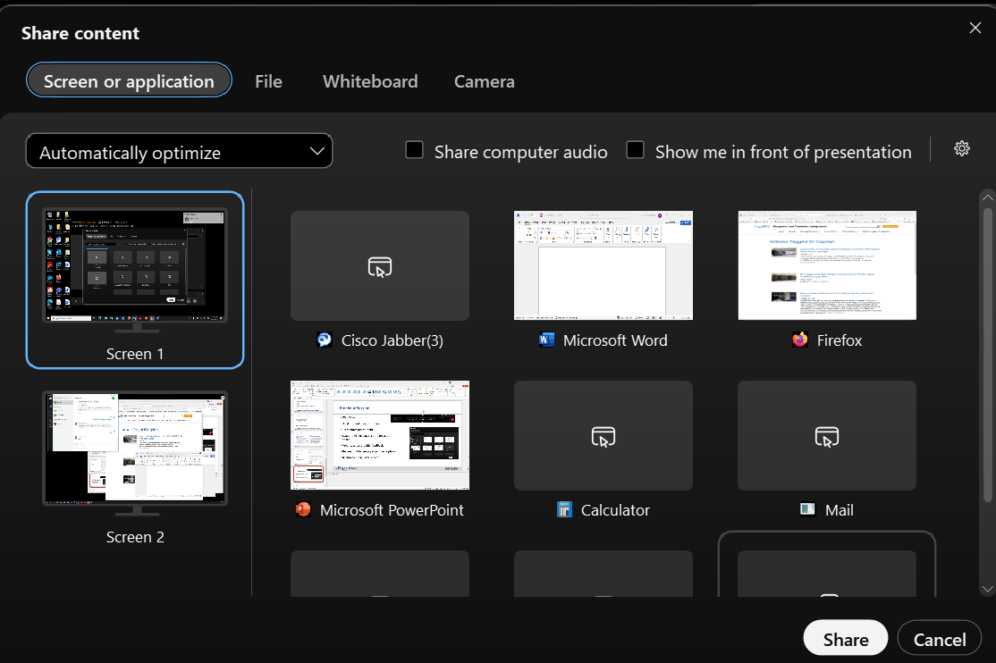
Breakout Session
30 - 45 minutes total
Student will display resume on screen share
Volunteers to provide feedback
Review Internship posting description
Return to main Q&A Session

Slide 19

Q&A Session
What is the difference between a resume vs. CV?
Is a cover letter required or recommended?
What does a person reading a resume notice first?
How to highlight transferable skills outside my major?
How to channel a resume at LLNL?
Notes:
Curriculum Vitae (CV) is a full history of your academic credentials, so the length of the document is variable
Resume is a concise picture of your skills and qualifications for a specific position, so length tends to be shorter and dictated by years of experience (generally 1-2 pages).
Attendees will receive a follow-up email with information for internships and posting dates.

Slide 20
Computing
computing.llnl.gov | computing.llnl.gov/careers

